Slide 1
Welcome to Year 3

Slide 2
Year 3
We would like to introduce you to the Year 3 team:
Miss Benton – Maple Class Teacher
Mr. George – Sycamore Class teacher
Mrs. Spincer – Deputy Head. Covering both Year 3 classes for a morning each week
Mrs. Nethercott – Lower Key Stage 2 Leader
Mrs. Dixon – Covering each Y3 class every other Thursday afternoon
Miss Harding – Year 3 Teaching Assistant
Mrs Commane – Playworker
Mrs Whittaker – Playworker
Other adults who may be in class:
Mrs Hoyle
Mrs Whittaker
Mrs Lewis
Mrs Perrett
Notes:
Dawn/Trish

Slide 3
Futura Learning Partnership
The trust’s core values were chosen with the help of staff, pupils and governors:
Pupils benefit from being part of the Futura Learning Partnership family of schools, where teachers and leaders work together across schools to provide the best possible education and enrichment
Pupils enjoy access to the Trust’s fantastic facilities at its other schools, for example sports events at the Wellsway Sport Centre
Respect | Opportunity | Collaboration | Aspiration
Behaving with integrity and worthy of trust; respecting yourself, others and the environment | Providing experiences for growth and development, opening doors for future success | Working together, towards shared goals and success; being strong together | Encourage ambition; providing the inspiration, challenge and support to achieve success in all its forms
Notes:
Liz

Slide 4
School Vision and Core Values
At Saltford C of E Primary School we believe anything is possible. We know that children have the right to be provided with a creative, innovative and exciting education that will inspire them to become lifelong learners who are enthusiastic and proud of everything they do. We want every child to excel in all aspects of their learning within an immersive, imaginative, expressive and inclusive environment. We want children to become confident discoverers, explorers and creators who live our Christian values. We keep children as the focus of everything we do.
“Caring for our Community”
Notes:
Liz

Slide 5
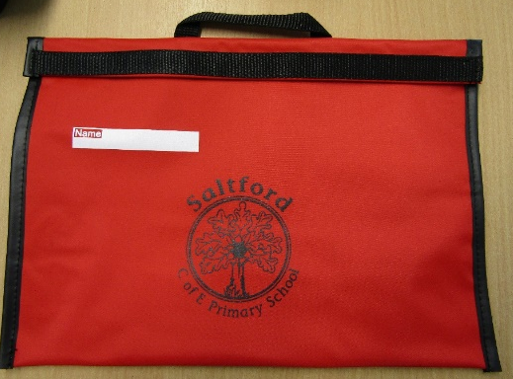
Uniform essentials
These are the essentials each child should come to school with everyday
Book bag – This is provided when the children join the school and if lost a new one will need to be purchased from the school office.
Sun hat for warm weather in the spring, summer and autumn
Water bottle – a sports lid is ideal to prevent spillages. We have filtered water units throughout the school for children to refill from.
Pencil case (small!) with pencils, rubber, ruler, coloured pencils, sharpener. No felt tip pens needed or possibly distracting stationary.
Please can all items be named so they can be returned if misplaced. The lost property box can be found outside the hall doors in the EYFS/KS1 corridor, opposite Lime Class.
Notes:
Trish

Slide 6
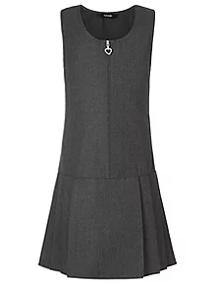
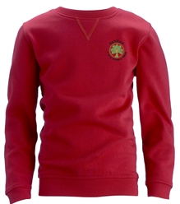
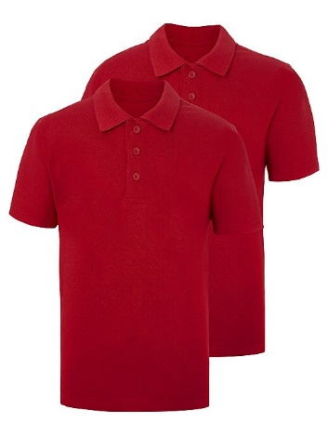
Autumn/Winter
Polo shirt (red or white with or without logo)
Shirt or blouse (white
Sweatshirt or Cardigan (red with logo)
Fleece (red)
Dress (no shorter than knee length), skirt or trousers (grey and tailored fit only)
Tights (grey, black, white or red)
Plain socks (white, black or grey)
Plain shoes (black) – shoes should be functional and comfortable, EYFS and KS1 children should wear shoes with Velcro. KS2 children can wear laced shoes provided they can tie them
It is our preference that the sweatshirt /cardigan bear the school logo. It is helpful for younger children to have uniform with elasticated waists.
Please name all uniform so it can be identified if misplaced
Notes:
Trish

Slide 7
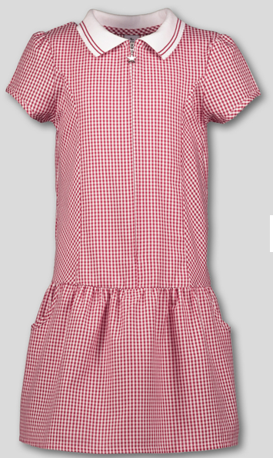
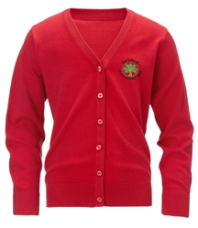
Spring/Summer
Polo shirt (red or white with or without the logo)
Shirt or blouse (white
Sweatshirt or Cardigan (red with logo)
Fleece (red)
Dress (no shorter than knee length), skirt, shorts or trousers (grey and tailored fit only)
Summer Gingham Dress or playsuit (red check)
Plain tights (grey, black, white or red)
Plain socks (white, black or grey)
Shoes (black) – shoes should be functional and comfortable, EYFS and KS1 children should wear shoes with Velcro. KS2 children can wear laced shoes provided they can tie them
It is our preference that the sweatshirt /cardigan bear the school logo. It is helpful for younger children to have uniform with elasticated waists.
Please name all uniform so it can be identified if misplaced
Notes:
Trish

Slide 8
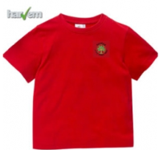
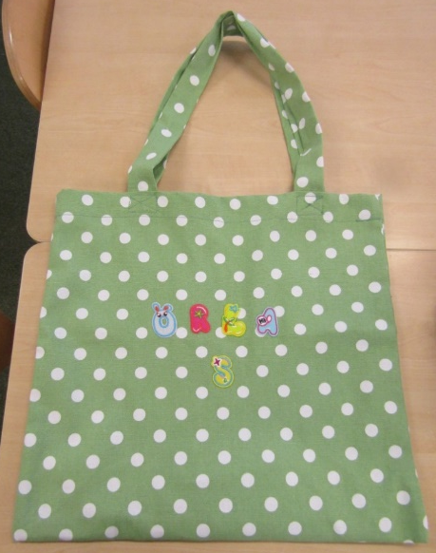
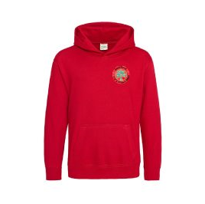
Uniform extras – PE Kit
Red T-Shirt - http://www.harvemschoolwear.co.uk
Red Hoodie - http://www.harvemschoolwear.co.uk
Plain Red round neck t-shirt
Black PE Shorts (no football shorts)
Black PE Trousers (for winter)
Trainers
Black plain track suit top (with or without a hood)
No large PE bags as these need to fit on cloakroom pegs
Notes:
Trish

Slide 9
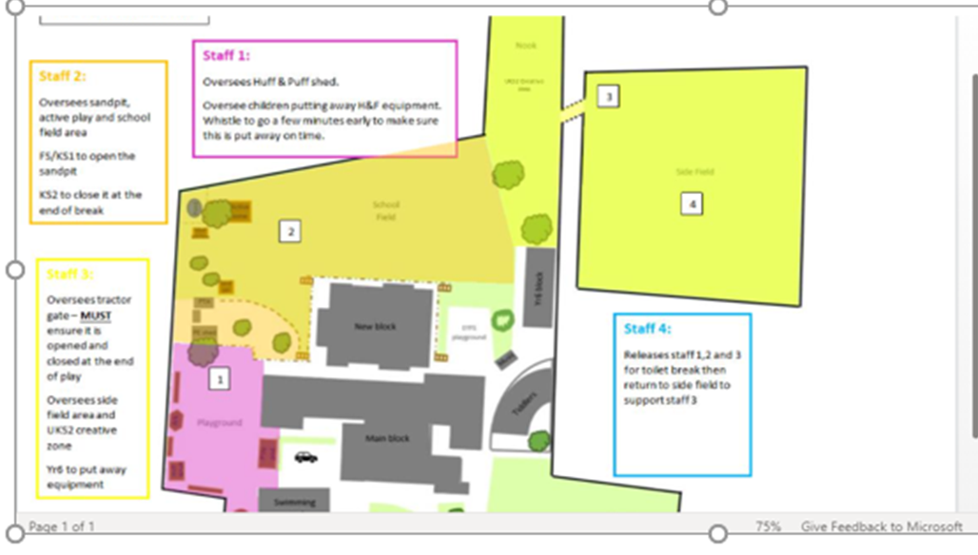
Uniform extras – Footwear
At Saltford School we recognise the value of the outdoor environment and as such we want the children to be spending their break and lunchtimes outside all year round, in most weathers.
The children have the option of free flow between the playground and the field during their breaks and as such they will need to ensure they have appropriate footwear for when the weather is a bit damp.
Please can you ensure your child comes to school with a pair of wellington boots or waterproof outside shoes that the children can change into. Classrooms have shoe stands/places for the footwear to stay in school all week but please make sure these are named.
Notes:
Trish

Slide 10
Drop off
We encourage children to walk, cycle or scoot to school, and provide cycle shelters and scooter pods for those who choose to do so. If you do need to travel by car, please be considerate of our neighbours when parking at drop off and pick up times.
Registration starts at 8.50am - therefore you child should arrive by 8:45am – the gates close at 8:50am also.
The main drop off point for Year 3 will be via the Claverton Road main entrance, through the car park (which will be closed) and onto the playground to the classrooms. However, it is not a problem to use other entrances if this is more convenient.
In Year 3, we encourage the children to be independent and get themselves to the classroom and find you at the end of the day. Please arrange a regular spot for them to meet you but remind them that if they can’t find you they must return to us.
Arrival | 8.40am
Registration | 8.50am
Lesson 1 and 2 | 9:00am – 10:45
Morning Play | 10.45am – 11:00am
Lesson 3 | 11.00am-12.00pm
Lunch | 12.00pm – 1.00pm
Lesson 4 and 5 | 1.00pm – 3.15pm
Home time | 3.15pm
Notes:
Beth

Slide 11
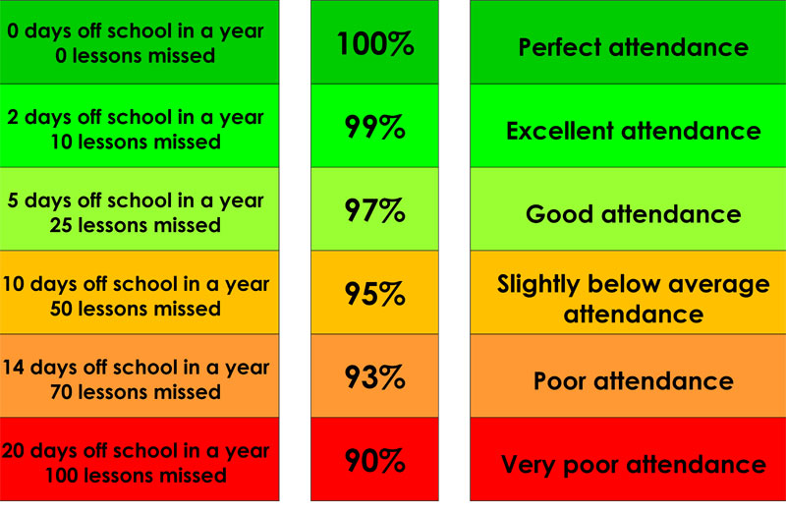
Attendance
It is our aim for every child to be in school every day. School gates are open and children should arrive no later than 8.45am. Register opens at 8:50am. After 8:50am, a child is marked as late. After 9.00am, it is marked as an unauthorised absence for the morning session.
Term Dates
Dates for academic terms are published on the school website before the start of each academic year.
Illness
If your child is too ill to attend school, please contact the school on the first and each subsequent day of absence on the school absence line before 8.40am. If you child is suffering with diarrhoea and/or vomiting, please allow 48 hours after this has ceased.
If you’re unsure whether or not your children should attend, we suggest speaking with the school office.
Notes:
Beth

Slide 12
Lunchtimes
Our school meals are provided by Zest Catering, Futura Learning Partnership’s in-house catering service. The management team at Zest prides itself on a "fresh, healthy and tasty" ethos. They are happy to support children with food allergies or intolerances.
Dinner money is £2.73 per dinner. School meals are free for all pupils in Reception, Year 1 and Year 2 in state schools in England. These are known as 'universal free school meals'. If you think your child may be entitled to free school meals please go and see the office.
In Year 3, the children will be on first sitting until Easter with the children in KS1. After that, they will join the older children for second sitting.
Here is an example menu:
https://www.saltfordschool.org.uk/assets/uploads/documents/dinners/Zest%20Primary%20Menu%20April%202023%20-%20Saltford.pdf
Notes:
Beth

Slide 13
Pick up
At the end of the day, children are dismissed via the exits of their classrooms.
Please let your child know where to meet you. This must be somewhere within the school grounds, please. Children will be told they must return to the classroom or the school office if they can't find their adult, please reinforce this with your child.
Arrival | 8.40am
Registration | 8.50am
Lesson 1 and 2 | 9:00am – 10:45
Morning Play | 10.45am – 11:00am
Lesson 3 | 11.00am-12.00pm
Lunch | 12.00pm – 1.00pm
Lesson 4 and 5 | 1.00pm – 3.15pm
Home time | 3.15pm
If you need to make changes to your child’s collection arrangements, please contact the school office via email.
Notes:
Beth

Slide 14
What learning looks like in Year 3
Smooth transition from Year 2 (Key Stage 1) and focus on learning through planned and objective led lessons
Pupil led enquiries as part of our Futura planned curriculum and rich learning experience
Regular use of the outdoor environment to enrich learning opportunities
Mindfulness activities e.g. Just Dance, Go Noodle brain breaks and Cosmic Yoga.
Learning and applying core skills of reading, writing and maths
Finding cross curricular links in learning
Using a wide range of texts, both fiction and non-fiction to engage learning
Notes:
Sam

Slide 15
Positive Behaviour
We aim to promote and reward positive behaviour, self-motivation, self-discipline and a sense of responsibility for our own actions. In all classes, positive behaviour is actively and explicitly encouraged, and publicly acknowledged and rewarded.
In Year 3, we use the Class Dojo system to reward positive behaviour; we work together towards a half termly reward.
We care deeply for our children and believe it is important that if children need to be reprimanded we make it clear that it is their behaviour we are rejecting, not them. Our aim is to ensure consistent high standards of behaviour. We are a happy, caring school and that is because we have high expectations of the children in this area.
Notes:
Sam

Slide 16
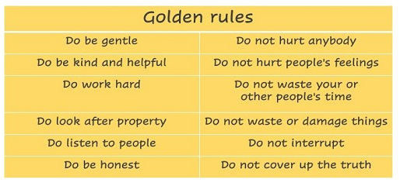
Golden Rules
Our golden rules are at the heart of school life.
Notes:
Sam

Slide 17
Anti-Bullying
‘The repetitive, intentional hurting of one person by another, where the relationship involves an imbalance of power.
Bullying can be carried out physically, verbally emotionally or through cyberspace.’ Here is our anti-bullying promise that sits within our Anti-Bullying Policy: https://www.saltfordschool.org.uk/assets/uploads/documents/key%20information/Anti-Bullying%20Charter%202017.pdf
Bullying of any kind is unacceptable at our school
• Everyone has the right to feel welcome, safe and happy
• We should treat everyone with respect
• If bullying happens it will be dealt with quickly and effectively
• Everyone should know where to get support if something happens.
Who can help: Any trusted adult who your child feels comfortable talking to.
Notes:
Sam

Slide 18
A typical timetable in Year 3 looks like this:
Notes:
Beth

Slide 19
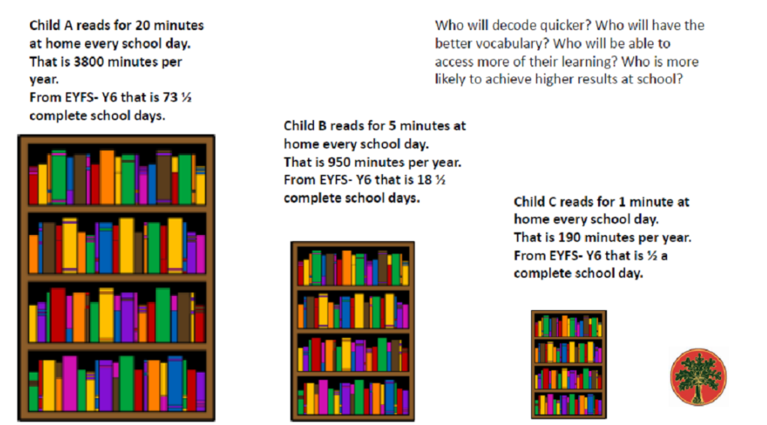
Daily Reading
We hold the ‘simple view of reading’ which means we focus on developing readers who read with fluency and accuracy and comprehend the texts they read and are read to them.
We develop children's understanding of what they read through:
Daily opportunities to listen and discuss texts read to them.
By using texts that are linked to children’s interest or the topics they are studying.
Through daily VIPERS lessons.
Reading Planners – regularly filled in and checked weekly
Notes:
Beth

Slide 20
English
Every morning we have a Whole Class Reading activity using a range of rich texts to extend vocabulary and encourage comprehension. Children will also be given the chance to change their home reading books, after discussing what they have read with an adult and by taking an Accelerated Reader quiz.
These are the topics that we will cover in writing this year:
Each term, we will study a different book which will be a focus for our writing, for example Sulwe. We will link grammatical skills to the text. We have deliberately chosen books that reflect a diverse range of topics and cultures.
In addition to this we will work on cross-curricular writing linked with our topics, eg A Study of Europe and North America in Geography.
We also explore language and vocabulary through poetry.
Notes:
Beth

Slide 21
Maths
Over the course of the year, Year 3 will cover a variety of topics including:
Number and Place Value
Addition and Subtraction
Multiplication and Division
Fractions
Measurement (including time)
Geometry
Statistics
Notes:
Beth

Slide 22
How to help with Maths at home
It is really important that you go over some maths topics at home:
Money
Time
Capacity
Notes:
Beth

Slide 23
How you can support your child
Practice your child’s maths homework and spellings with them frequently
Recap previous learning too.
Practice handwriting
Practice the methods taught in maths with your child to build fluency.
Buy your child a watch and get them to tell the time as much as possible.
Allow your child to use skills learnt at school in real life situations such as measuring ingredients for a recipe, paying in a shop, sharing their sweets equally between friends (and hopefully you!), writing letters or postcards and typing emails.
Use the websites and apps, including TT Rockstars and Doodle, shared with you to support your child.
Read with your child every day to support their fluency, expression, reading comprehension and vocabulary
For our topics each term there may be other elements of homework linked to what your child is learning. This will be at the discretion of the class teacher.

Slide 24
PE
Here are the topics for PE this year:
Term 1 | Term 2 | Term 3 | Term 4 | Term 5 | Term 6
Football Mindfulness | Weather Basketball | Symmetry & Asymmetry Tennis | Wild Animals Hockey | Rounders Athletics | Communication & Tactics Competitions
Notes:
Sam

Slide 25
History/Geography
Here is our History and Geography topics this year:
Term 1 | Term 2 | Term 3 | Term 4 | Term 5 | Term 6
A study of Europe and North America | Stone Age Egyptians | Earthquakes and Volcanoes | The Greeks Mayans | The UK National parks; The local area | Romans Vikings
Notes:
Sam

Slide 26
Science
Here are our Science topics for this year:
Term 1 | Term 2 | Term 3 | Term 4 | Term 5 | Term 6
Electrical circuits | Living Things Animals and Humans | Investigate Materials Magnets | Plants and the environment | Light and sound | Rocks and Fossils
Notes:
Sam

Slide 27
RE/Music/PSHE/French
Here are the themes for RE, Music, PSHE and French this year:
Topic | Term 1 | Term 2 | Term 3 | Term 4 | Term 5 | Term 6
RE | Hinduism – Divali | Christianity – Christmas | Christianity – Jesus’ miracles | Christianity - Easter | Sharing and Community (Sikhism) The 8-fold path (Buddhism) | Pilgrimage to the River Ganges (Hinduism) Hajj (Islam)
Music | Following the Active music scheme of work
PSHE | Being Me | Celebrating Differences | Dreams and Goals | Healthy Me | Relationships | Changing Me
French | J’apprends le francais (Y3) Les jours (Y3) La phonetique (lesson 1) | A story in French: La chenille qui fait des trous | Chez Moi (Y3) | A story in French: Le Roi tete en l’air | Le Petit Chaperon Rouge (Y3) | A story in french: Va t’en Grande Monstre vert!
Notes:
Sam

Slide 28
Homework
Reading - we would suggest that your child reads every day for around twenty minutes each time - little and often is usually best! Please comment in, and sign your child’s reading record every time they read to you adding H to show they have read at home. Planners will be checked every Monday by the class teacher.
English homework – The spelling list will be stuck into planners each week. Please support your child to use 5 spellings in a well presented sentence. These will be checked on the morning of the test. The spellings will be practised each morning in class. Which day this is will be specified in our class letters at the beginning of term.
Maths homework - To support your children at home in maths, we would suggest encouraging them to practise their times tables regularly. Daily practise of this will take place in school and weekly checks on a given day each week (see class letter at the beginning of term.
In Year 3 we also ask that the children log in to Doodle Maths at least 3x weekly and earn a minimum of 30 Doodle stars. Both classes will be monitored for this on a Friday. Please support your child to work out a routine when this can be completed that fits in with clubs, after school activities, family time etc.
We also recommend undertaking practical tasks such as board games, creating art work using different shapes, weighing ingredients for cooking, paying for items in shops and telling the time.
Notes:
Beth

Slide 29
Doodle
Doodle:
We are pleased to tell you that we use Doodle, the award-winning homework programme. If you do not have the class code letter or your child have forgotten their password, please contact your child’s teacher via the school office.
We have access and encourage you to take full advantage of:
Doodle Maths
Doodle Tables
Doodle English
Doodle Spell
Has been proven to help children make big improvements in both their ability and confidence - using for 10 minutes a day has helped children make 3 month’s progress in just 1 month.
Learns what your child’s strengths are, and what they need to work on, then builds a programme just for them.
Is fun and engaging!
It’s easy for you to be involved at home by using the Parent Connect app and the Parent Dashboard to track their progress. If you have any issues with Doodle, please contact them as they are more than happy to help.
Notes:
Beth

Slide 30
Seesaw
We are very pleased to have Seesaw as an important additional tool for us to provide education for our children in Years 1-6. This is used for homework by the older KS2 classes, but not in Y3. We do upload some of the work that the children do in their foundation subjects. This is more for us to keep record of some of their non-recorded work and you don’t have to respond to it but you might be interested to see it.
Seesaw is a secure online learning environment for children that provides a platform for communication between children, parents and school. It supports creative learning by enabling use of photos, videos, drawing and notes.
All families will have received a letter that outlines what teachers and parents can expect from this new platform, how to get started and how any privacy and safeguarding concerns are covered.
Please see this link to our website where you will find a useful video and guide on how to use: https://www.saltfordschool.org.uk/news/#seesaw
Notes:
Beth

Slide 31
Spellings
We teach spelling patterns, initially through the application of phonic knowledge linked to the phases and then in line with English Appendix 1 from the National Curriculum.
This is achieved through specific teaching of grapheme- phoneme correspondence in phases 2-6, guided by the Read Write Inc scheme, in EYFS and KS1. This also includes irregular and common exception words for each relevant year group.
Children in EYFS are regularly assessed for their application of their phonic knowledge and children in Year 1-6 undertake weekly spelling tests linked to the taught phonemes.
For those children who find spelling challenging, lists are adapted in line with their current need and interventions such as Nessy, Read, Write Inc or Precision Teaching may be used to support their progression.
Spellings will be given out and tested on a given day each week (see class letters at the beginning of term).
Notes:
Beth

Slide 32
Times table Rockstars/Numbots
Times Tables Rockstars and Numbots are carefully sequenced programmes of daily times tables and addition and subtraction practice.
Times Table Rockstars and Numbots are aimed at securing addition, subtraction, multiplication and division recall. It allows all children to built their fluency and reinforces key calculation skills and complements your child’s work on DoodleMaths.
Numbots is a platform designed for boosting number recognition and addition and subtraction skills. It is important that your child develops efficient mental calculation strategies to add and subtract two-digit numbers, so that they can leave counting on their fingers behind, and NumBots will help do this.
Times Tables Rockstars is a carefully sequenced programme of daily times tables practice. Each week concentrates on a different times table, with a recommended consolidation week for rehearsing the tables that have recently been practised every third week or so.
By the end of Year 4, children are expected to know all of their times tables so your support is greatly appreciated.
Notes:
Sam

Slide 33
Class Visits
We are planning these class trips this year in Year 3 and they will take place in the terms as detailed below. We will send out more information about each visit closer to the time.
Term 1 | Term 2 | Term 3 | Term 4 | Term 5 | Term 6
 | Visiting pantomime |  | Greek Day | Ascension Day Walk | Visit to the Roman Baths
Notes:
Sam

Slide 34
Extra Curricular Clubs
Mollie Moon Sewing Club - For Years 2 - 6.
Funky Art Club - For Years 3-6.
Ricky’s Football Club – For Years 1-6
Spanish Club - For Years 1-6
Girls Netball Club – For Years 4-5
School Netball Team - For Year 6
Gymnastics Club
Tom Baker’s Cricket Club – For Years 1-6
Danni’s Dance Academy – For Years 3 – 6.
The STEM Factory - For Years 3-6
Basketball Club - For Years 3-6
Recorder Club
Mr George’s Choir – For Years 3-4
https://www.saltfordschool.org.uk/assets/uploads/documents/clubs/club%20timetable.pdf
Notes:
Sam

Slide 35
Music Lessons
We offer a variety of musical instrument lesson at school:
Guitar
Flute
Clarinet
Saxophone
Drums
Violin
Voice
Piano
Recorders
If your child is interested in Music Lessons, please contact the school office for further details.
Notes:
Sam

Slide 36
Useful information and websites
DoodleMaths - English, Times tables, Spellings
TT Rockstars
Top Marks Maths
Numbots
BBC Bitesize
Love Reading 4 Kids
Accelerated Reader
Notes:
Sam

Slide 37
How to contact us
You can contact us in many ways. We look forward to hearing from you. Any emails sent for the attention of the class teacher will be forwarded to them.
01225 872185
contactus@saltfordschool.org.uk
www.saltfordschool.org.uk
Notes:
Sam

Slide 38
Thank you for attending
Any Questions?
Notes:
Beth

